Slide 1
Design for testing and FA
Yariv Shlivinski

Slide 2
Design and Layout for failure
“Success is the ability to go from failure to failure without losing your enthusiasm.”

Slide 3
Design and Layout for testing, failure analysis and failure mitigation
Three kinds of tests:
  R&D
  Certification
  Production line
Two kinds of FA:
  R&D+Q&R
  Field remote

Slide 4
Design and Layout for Lab testing

Slide 5
Auxiliary
Secondary auxiliary
  Internal Low DC -> Low DC
  Only black box testing
  Need to be able to separate input and output for testing.
D1999BB - PortiaX

Slide 6
Auxilaiary
Main auxiliary:
  In most cases the output is a diode. It is easy to inject voltage at the output.
  White box
  Need to measure internal parameters:
    Loop transfer function

Slide 7
Main Auxilaiary
Jupiter 3

Slide 8
Main Auxiliary
Add small serial resistance in feedback path.
  Network analyzer (Bode 100) connection point

Slide 9
Bode 100
The following figure shows the feedback loop of the circuit and indicates the suitable injection point. The impedance looking backwards equals the output impedance of the converter which is very low (in the range of several mΩ). The impedance looking in direction of the loop is formed by the compensator and the voltage divider and is in the range of several kΩ.

Slide 10
Auxiliary Current FB
Do not add test points to CS.
  Current sense is very sensitive to noises. Avoid having stubs/antennas on that line.
3
1
D403
2
1N4148
R416
R412
2N7002KW
R415
13
4
*
*
1
R418
1K
AC_VREF
AC_PWM
R419
30
1
Q402
20
20
C405
R420
MSJU04N80A
2
Q401
100n
3
C406
10K
*
ACDC_CTRL-
100p
R421
C413
CS_AC
4.99K
2.2n
R422
R423
ACDC_CTRL-
1.3
1.3
U401
ACDC_VCC
7
UCC28C54
6
AC_PWM
AC_VREF
8
VDD
OUT
2
R425
20K
AC_FB
AC_Rt/Ct
4
VREF
FB
1
AC_COMP
R426
20K
ACDC_CTRL-
5
RT/CT
COMP
3
R429
1000
CS_AC
GND
CS
TP407
50% DUTY
AC_VREF
R438
1
D409
C432
30K
*
AC_COMP
AC_FB
AC_Rt/Ct
150p
BAV21
2
R440
Fsw=100kHz
2
1
MMBTA56
3
Q405
1000
C439
C438
100n
47n

Slide 11
Digital
Peripheral Connection

Slide 12
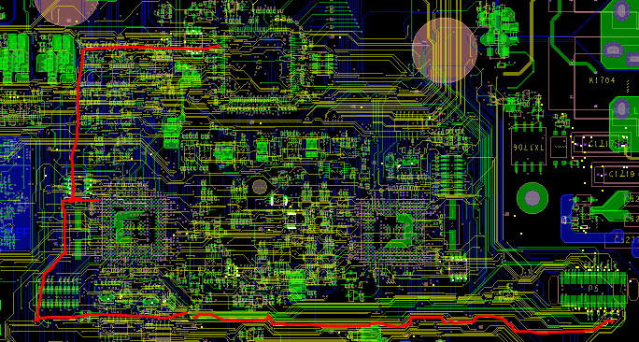
Debug card
Debug Card is connected and used only in lab.
  When not used SPI lines become stubs and antennas. Signal is both distorted and collects noises.
FPGA
MNGR
PWR
DBG

Slide 13
Example V4
MNGR to Debug connector 20cm
FPGA to Debug 25cm
Solutions:
  Place Debug connector close to manager
  Use 0 ohm resistors to disconnect.
FPGA
MNGR
PWR
DBG

Slide 14
Example V4 (what we intended 🙂)
FPGA
MNGR
PWR
RES
DBG
14

Slide 15
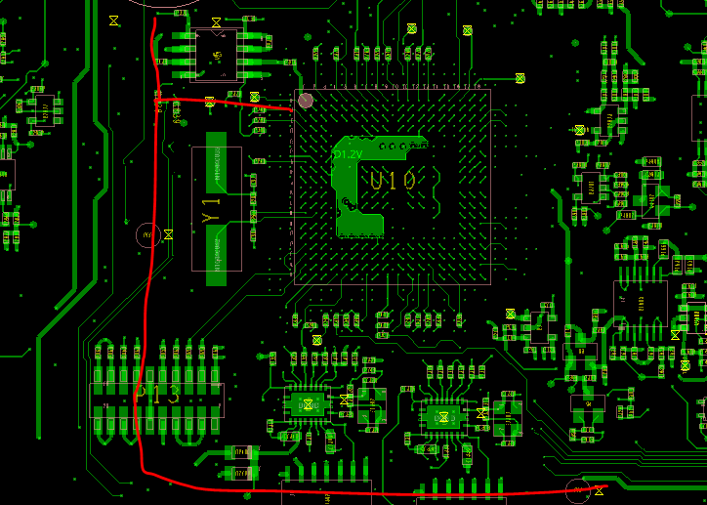
Example V4 (What we implemented ☹ )
Even best solutions should be implemented correctly.
MNGR
RES

Slide 16
Functionality: make sure to comply with lab equipment
  Debug card pulls.
Do we need legacy?
  ATP of RESET
Automated test equipment
  Prefer to use low voltage/low current equipment
Not supported by software but mauntains the opportunity for future
Aux
  AC/DC who is on
  Voltage/current

Slide 17
Temperature is a good predictor
How much money/effort/space should we invest?

Slide 18
Temperature measurement
Important mainly for remote FA
System level testing
Performance depends on ambient
Need calibration temperature sensor
  HS measurement?
Sensor should be located as close as possible to device in question
  Clearance creepage.
  Two possible solutions:
    CTM – heat transfer through different layers.

Slide 19
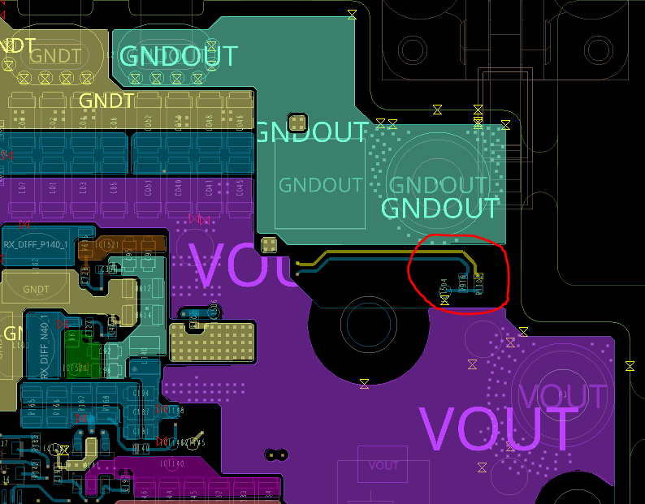
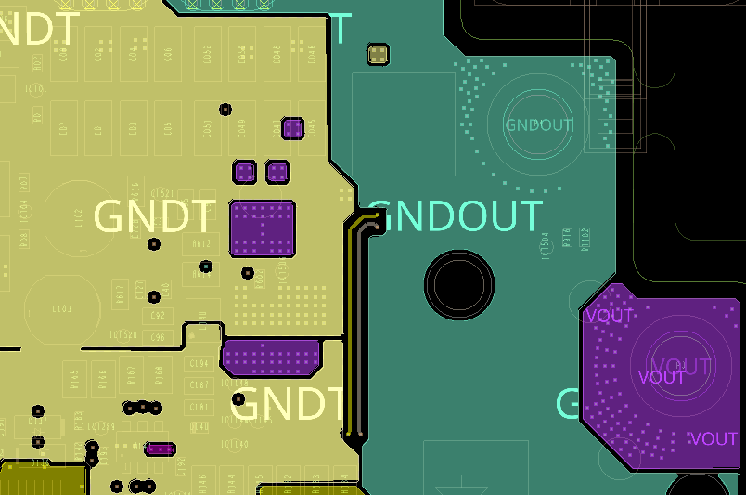
CTM (H1300)
Maximum metal around thermistor

Slide 20
Temperature senses
  Ambient
  Enough
  Location
  Heat transfer
Need to be able to differentiate between measurements.
Test points on the lab side
Grounds.
Isolate blocks from source/load
Cost?
Telemetry (Fans)
Area?

Slide 21
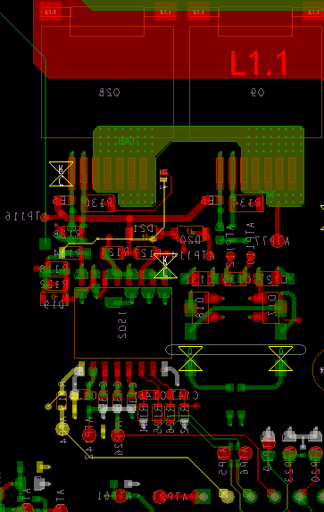
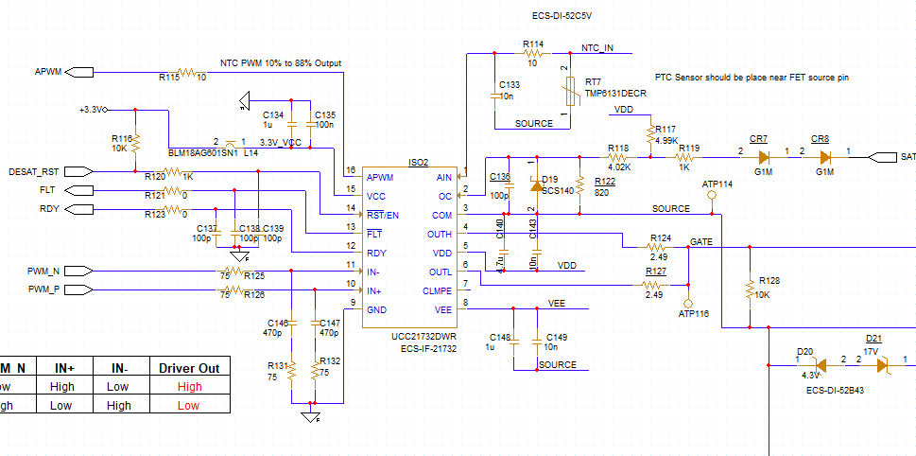
RSS2.5
Analog isolation

Slide 22
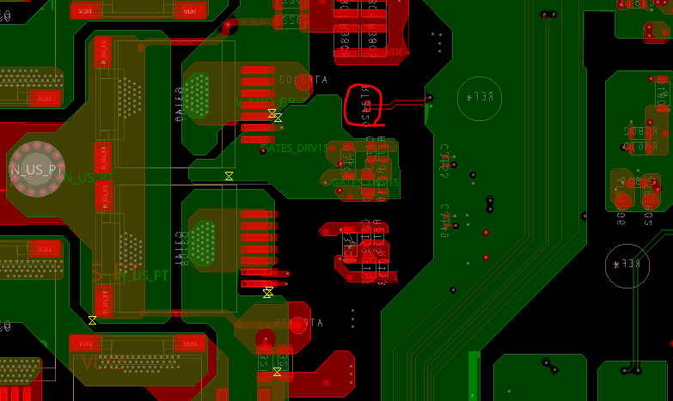
V4
sss

Slide 23
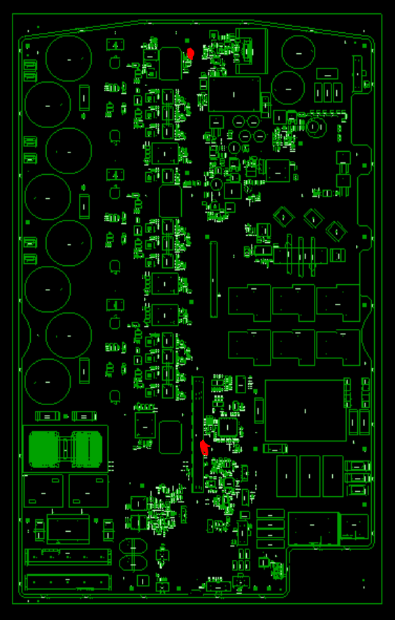
JPI
Single temperature meter
Sigle desat trip
Main Aux voltage

Slide 24
Debug Connector
FPGA
MNGR
PWR
DBG

Slide 25
Debug Connector
MNGR to debug SPI line is 25cm.
For “operational” assembly the debug buffer is not connected and the MNGR to debug SPI is not used.
STUB with length of 25cm
  Double clocking.
  Increased rise/fall time due to extra capacitance.
  Ringing
Solution add resistor in the branch point and assemble only when debug connector is used.

Slide 26
Debug connector
FPGA
MNGR
RES
PWR
DBG

Slide 27
DEBUG PULLS
DEBUG SPI default is low.
DEBUG output is push-pull
When debug catd is connected it is impossible to use pull-ups and assume default high for UUT.

Slide 28
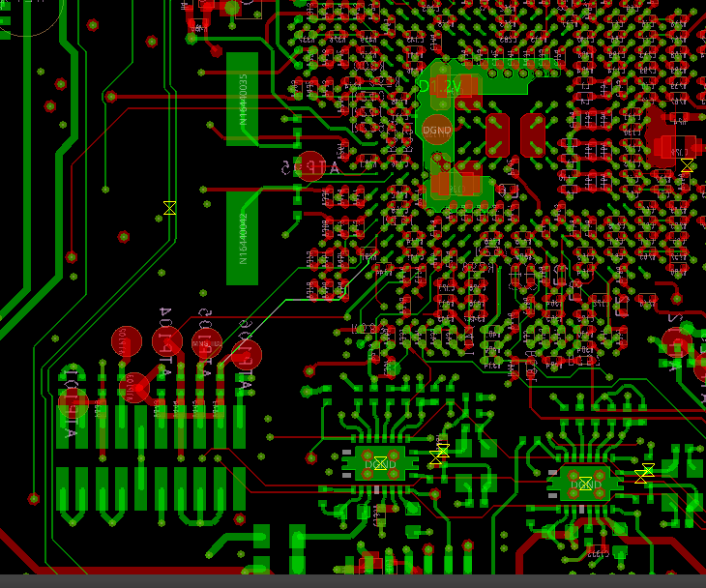
JTAG
JTAG resets the DSP
To avoid false RESET the line should be pulled as close as possible to the DSP pin.

Slide 29
Production line
What do we test
  Functionality
What we do not test
  Crystal
  Legs of sensitive silicone
Self test
Thermal attachment
ATP
ICT
Grounds
Avoid stubs

Slide 30
Auxiliary
Output/Input resistors for isolation.
TPs both on lines end grounds.
TPs on visible side.

